Slide 1
Knight Finder Group 12
Summer 2018

Slide 2
Group Members
Jason Portillo
Dustin Huff
Miguel Ramirez
Mike Owens
Bernardin Dezius
Mohamed Ait Bella
Anirudh Singh

Slide 3
Goal
To construct a contact manager application
The application should be able to add, delete, and search for contacts.
It should be able to let the user create an account and sign up.

Slide 4
Overall Layout
WISA Stack
Microsoft SQL Database
C# API
“Sha1” Hashing Algorithm

Slide 5
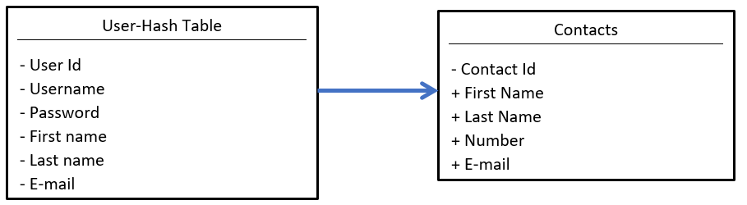
Class/Database Diagram

Slide 6
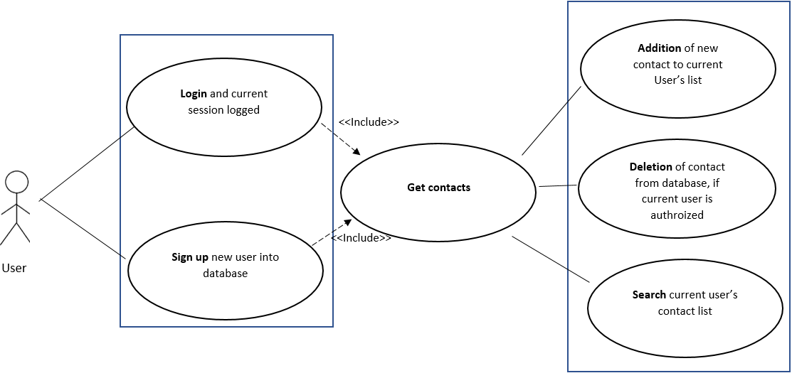
Use Case Diagram

Slide 7
Description
The user is first prompted for the username and password.
If the user is new the they can sign up by clicking on the sign up button to create a login and password.
Once login is initiated the credentials are cross-referenced with the data on record with the database.
Upon successful login user may choose between search current contacts or add a new contact.
If the search option is selected then the user must provide a name and then the system returns any matching data to the user and now the delete option is available to the user.

Slide 8
Description (continued…)
If the add option is selected then the user provides relevant information.
This information is then update in the database.

Slide 9
JAVASCRIPT
Jquery POST requests to the API
Create Account
Login
Add contact
Search contacts
Delete contact

Slide 10
HTML FORMAT
Used divisions to hide/show pieces of the website based on the selections made by the user.
Took shell provided in the code posted by Professor Leinecker and modified it along with providing a slightly improved UI.
Used a combination of HTML and a CSS style sheet to create user interface.
Worked in collaboration with JavaScript to ensure all input IDs matched the corresponding field names in Javascript.

Slide 11
SQL QUERIES
Insert New Contact
Delete Contact
Retrieve Info
Update Contact
Get All Contacts

Slide 12
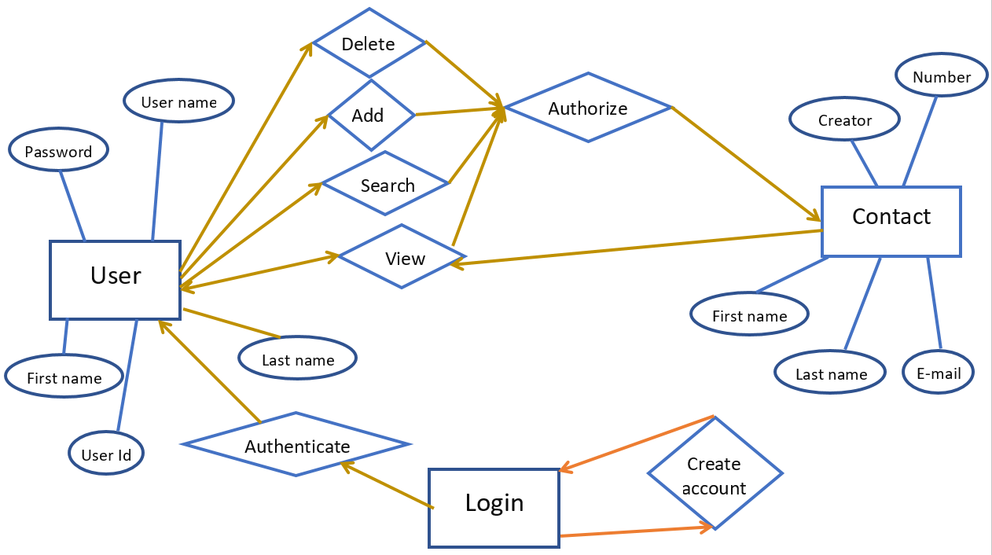
ENTITY RELATIONSHIP DIAGRAM

Slide 13
Demo
http://www.knightfinder.com

